Slide 1
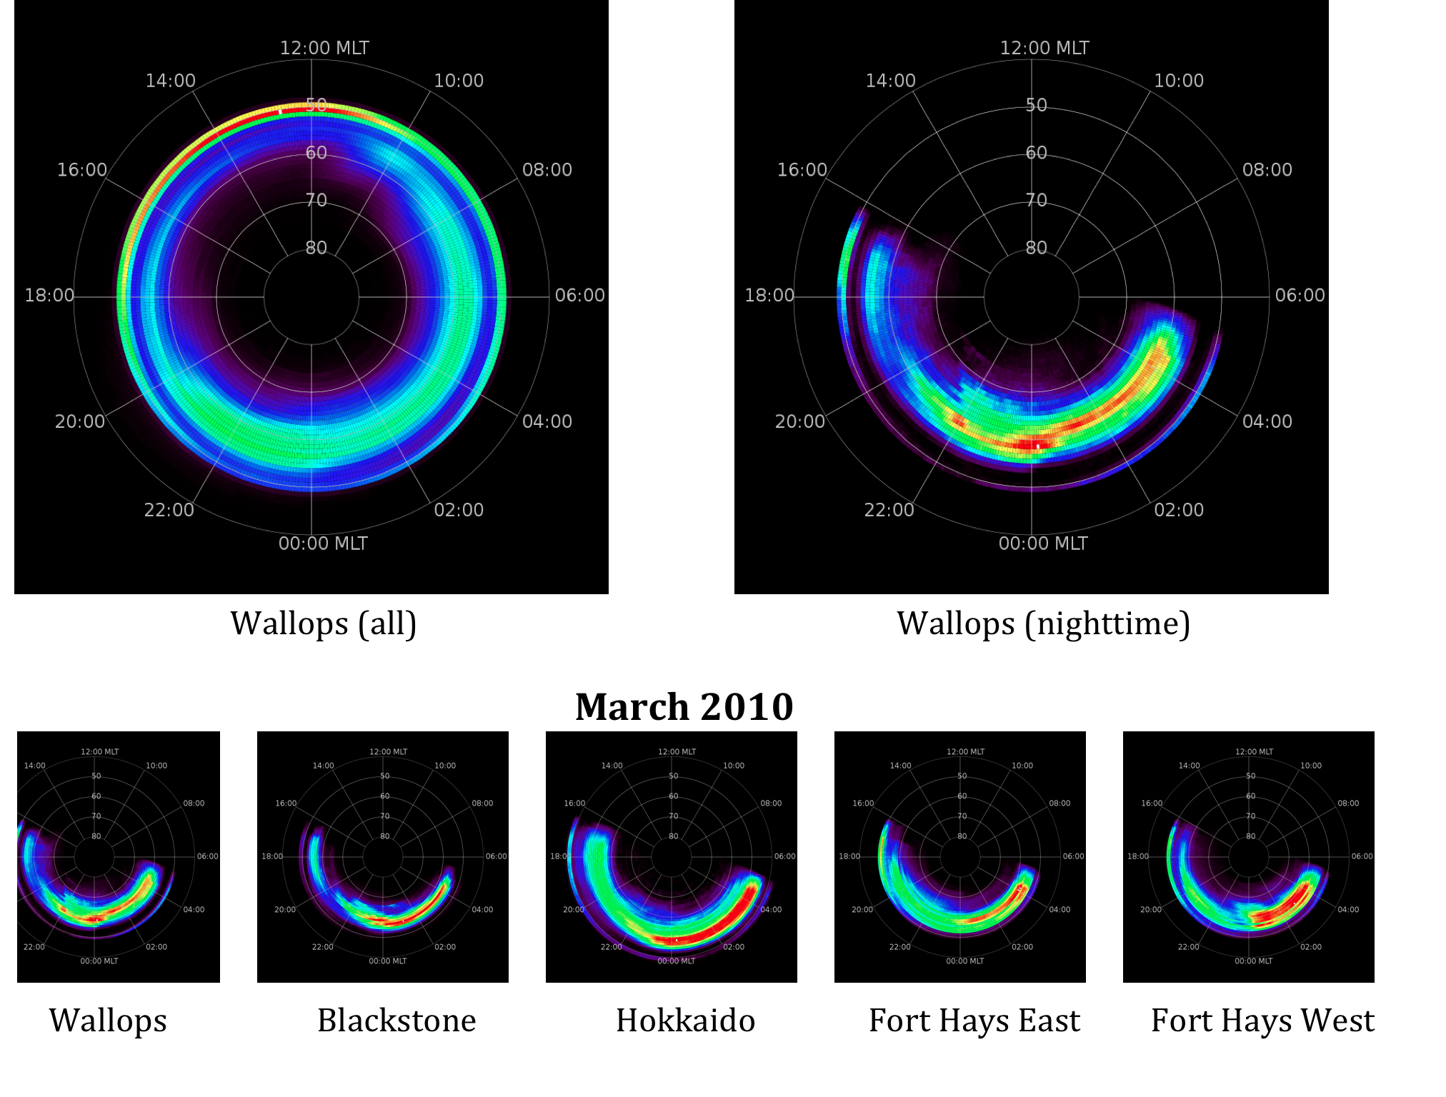
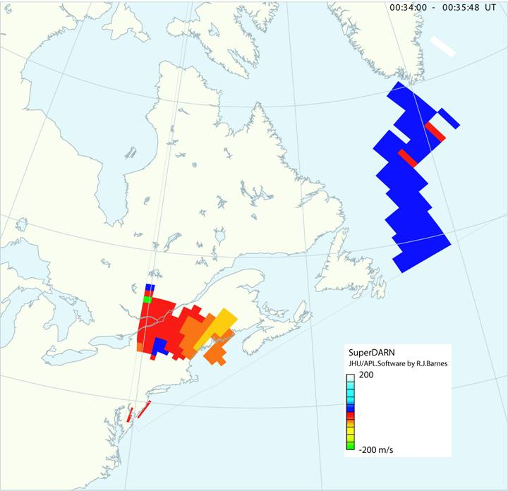
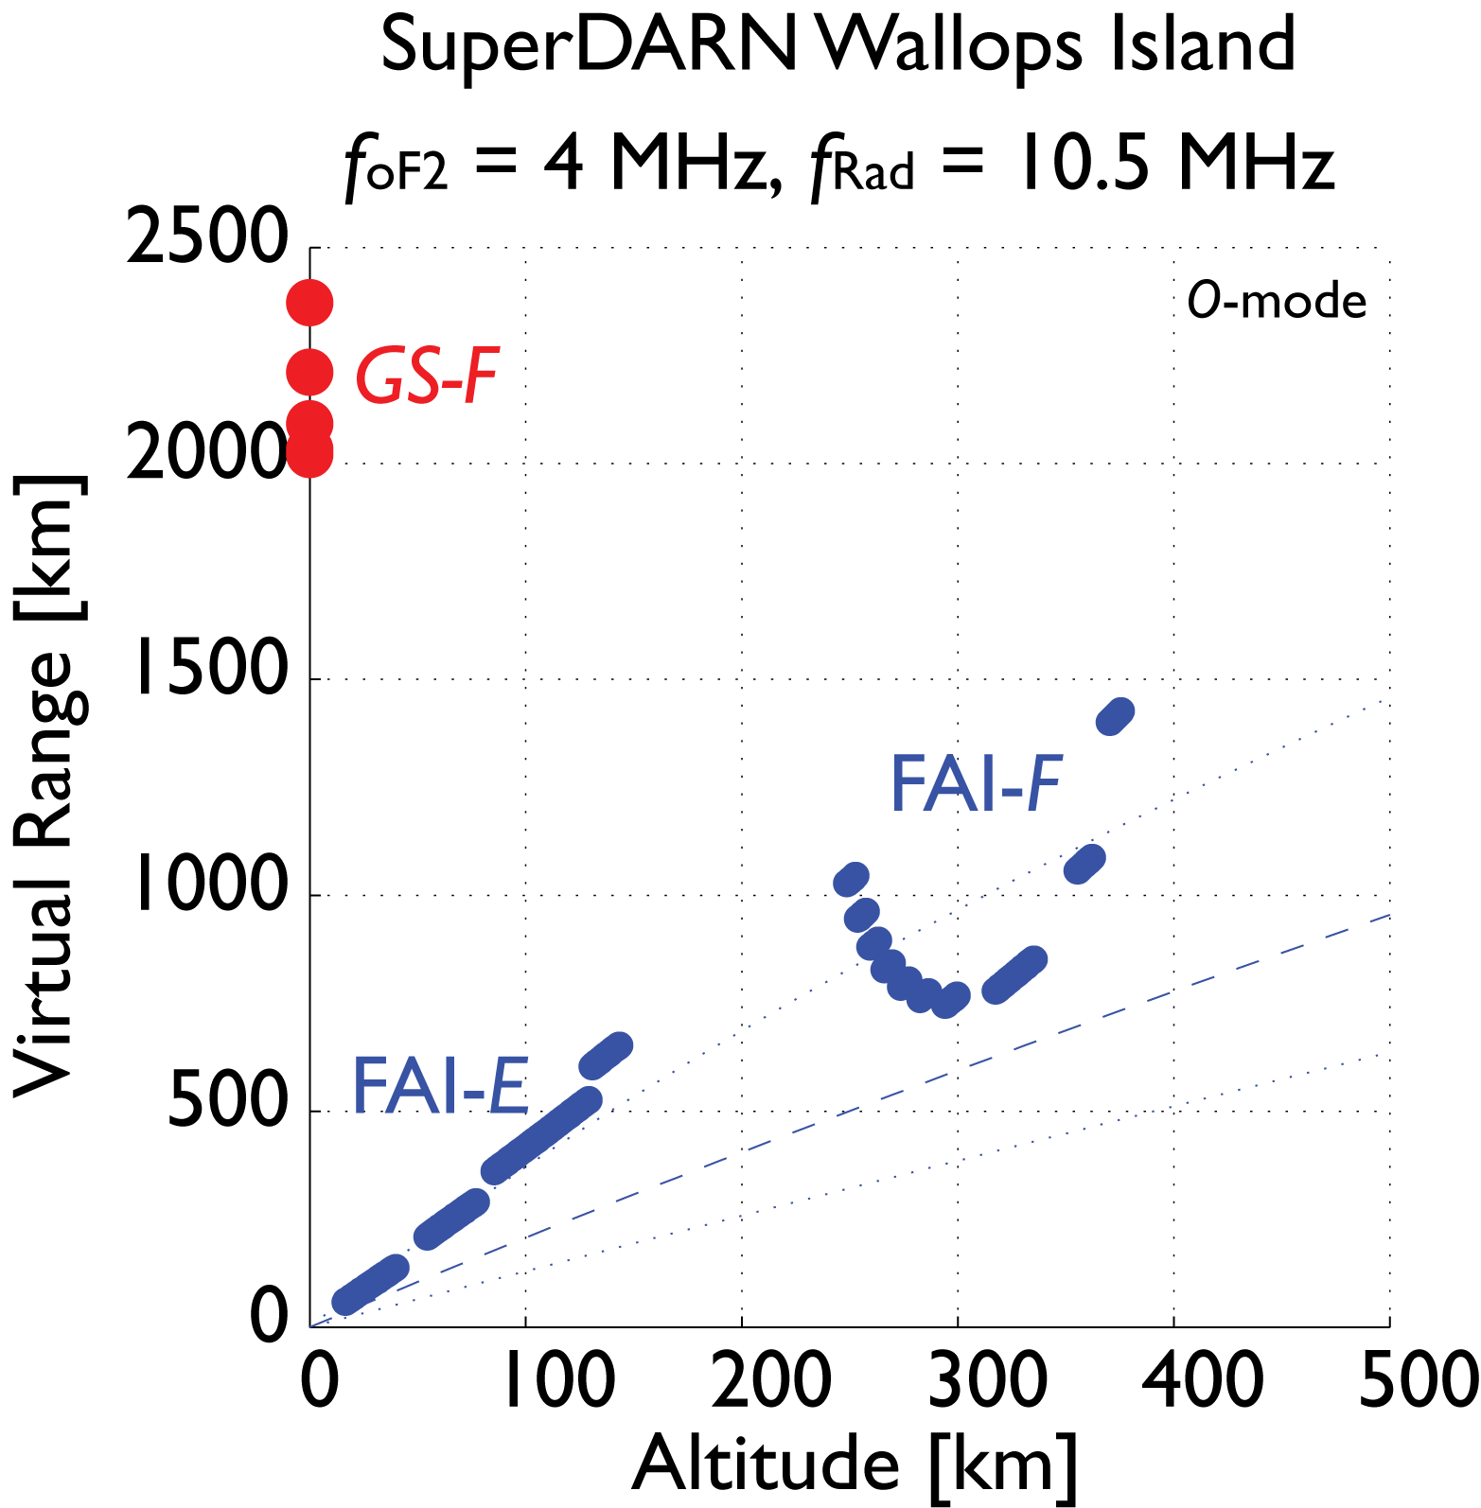
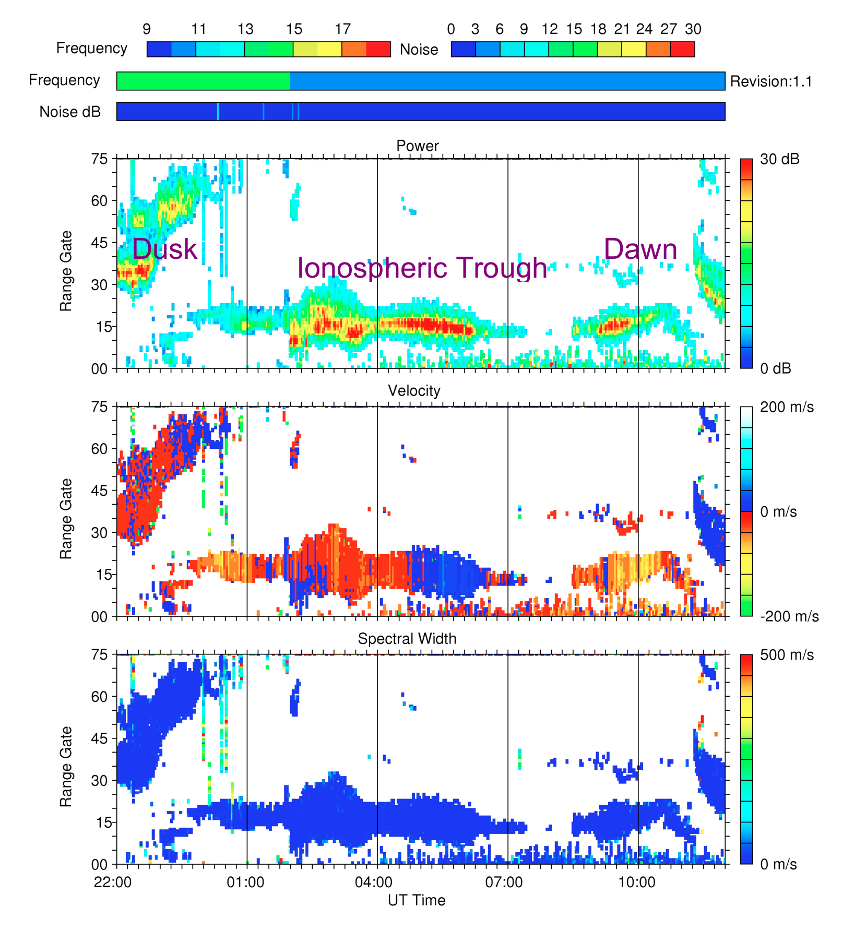
Extended observations of decameter scatter associated with the mid-latitude ionospheric trough
E. R. Talaat¹, E. S. Miller¹, R. J. Barnes¹, J. M. Ruohoniemi², W. Bristow³, R. A. Greenwald², S. G. Shepherd⁴
¹The Johns Hopkins University Applied Physics Laboratory, ²Virginia Tech University, ³University of Alsaska, ⁴Dartmouth College
elsayed.talaat@jhuapl.edu
ABSTRACT
Nighttime Observations
SuperDARN Data Processing
We present extended scatter observations that are associated with the nighttime ionospheric mid-latitude trough. Using data from five mid-latitude SuperDARN HF radar sites, including two radars with greater than 4 years of observations, we are able to compare with trough observations derived from electron density occultation measurements obtained from the COSMIC suite of satellite. We examine the scatter characteristics with respect to trough depth and location. Additionally, we examine longitudinal differences between sites and climatology as a function of seasons and local time.
As discussed by Greenwald, et al (2006), sub-auroral decameter irregularities exhibit low Doppler velocities and are often misclassified as ground scatter by the SuperDARN analysis algorithm. In this section, we discuss the technique employed to discriminate scatter from field-aligned irregularities (FAI) in the E- and F-regions and that from the ground, as well as the discrimination of auroral and sub-auroral irregularities.
A coarse estimate of the loci of perpendicularity has been derived from raytracing for each radar in its typical “nighttime” operating mode. Taking the Wallops Island, VA, radar as an example, the HF ground scatter (“skip”) virtual range is at about 1500-2200 km for foF2 = 5 MHz, hmF2 = 300 km, and fradar = 10500 kHz. FAI is only detected when the radio wave propagation vector is nearly perpendicular to B, a condition satisfied in the E region for virtual ranges between 200 and 400 km, and in the F region between 500 and 1500 km. The F-region FAI criterion is true for all beams of the Wallops Island radar. However, ground scatter from a sporadic-E layer will cause returns in the 500 to 1000 km virtual range gates. Furthermore, F-region ground scatter can contaminate the 1000 to 1500 km ranges.
SuperDARN at mid-latitudes
Wallops Radar field of view on March 3, 2006 23:52:00 UT. The near range velocities are due to irregularities due to the ionospheric trough­/plasma­pause. The far range velocities are due to groundscatter. The trough feature persists through the night
Sporadic-E layers are often accompanied by FAI or specular echoes at close ranges. Therefore, many false trough events generated by sporadic-E may be removed by identifying spatio-temporally coherent patches of scatter at close ranges. Evening and nighttime F-region ground scatter is almost universally associated with the evening decline of the F region due to recombination and the morning revival due to ion production as solar FUV falls on the ionosphere. This effect is discriminated by choosing scattering regions for which SZA > 90 deg. However, there is some residual ionosphere post sunset that contributes to the FAI statistics.
Normalized occurrence frequency of scatter at five mid-latitude SuperDARN sites. Top left figure is compiled from 5 years of Wallops data and the top right is filtered for SZA > 90Λ. The bottom five figures show frequency during only one month, March 2010 at five different mid-latitude radars.
Traditionally, the SuperDARN network was ideal for research interests relating to high latitude convection but not optimal for investigations of the expanded auroral oval or the mid-latitude ionosphere. However, recently, members of this team have installed two Su-perDARN radars in Virginia: one at Wallops Island (37.9°N, 75.5°W; 49.4°Λ) that began op-eration in May, 2005 and the other at Blackstone (37.9°N, 75.5°W; 49.4°Λ) which began op-eration in January, 2008. These two radars were supplemented by an additional mid-latitude radar in Hokkaido, Japan (43.3°N, 143.6°E; 38.1°Λ) that has been operational since December, 2006. The SuperDARN two additional radars were constructed in Fort Hays, Kansas (38.9°N, 99.4°W; 48.7°Λ) and two at Christmas Island have been operational since January 2010 and November 2010, respectively. The new radars have extended SuperDARN measurements to the mid-latitude ionosphere and have per-formed extremely well. It is these mid-latitude radars that we will focus on in this study. All other radars (in both the northern and southern hemisphere) have an invariant latitude greater than 55°, resulting in minimal ionospheric trough coverage.
COSMIC data
We geolocate the scatter from SuperDARN with respect to the trough using the electron density measurements obtained from the COSMIC suite of satellite. The FORMOSAT-3/COSMIC mission is a collaborative Taiwan-USA science experiment that has deployed six microsatellites in low Earth orbit for weather forecasting, climate monitoring, and atmospheric, ionospheric and geodesy research since 2006. Each satellite payload includes a GPS occultation experiment (GOX). The GOX collects the GPS signals for the study on atmosphere, ionosphere, and geodesy. The ionospheric occultation data is used to create monthly and seasonal climatologies of the three dimensional ionosphere at each radar site. Occultations are distributed all around the globe and an individual occultation cannot be interpreted as a single vertical profile of electron density as the occultation is taken over a wide swath in latitude and longitude. We do not use individual profiles as a unit, but instead treat each altitude as a separate data point which composited over a long enough time period provides a considerable amount of coincidence with the radar measurements for comparison and use in specifying the location of the mid-latitude trough. The data presented here is gridded in 1º MLAT and 1 hour MLT resolution for 15º wide MLON bin at a given radar site.
SuperDARN at mid-latitudes
The scatter is organized and largely contained in the trough region.
In addition, the scatter maximizes on the equatorward edge of the trough.

